Slide 1
5CS022 Distributed and Cloud Systems Programming
Actors vs Threads

Slide 2
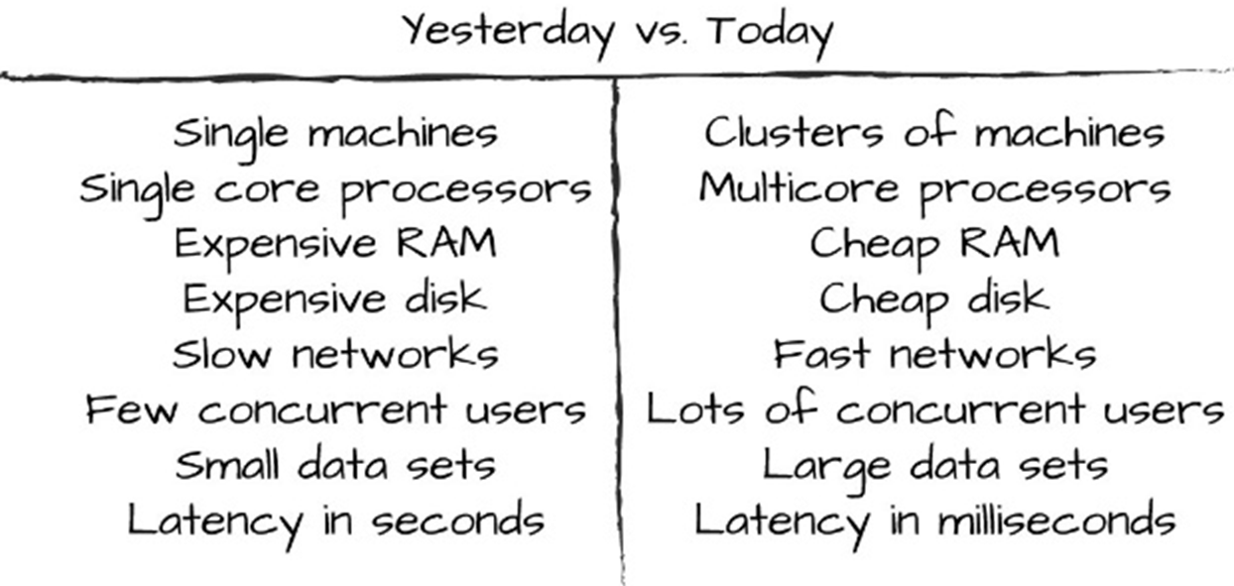
Why Actors?

Slide 3
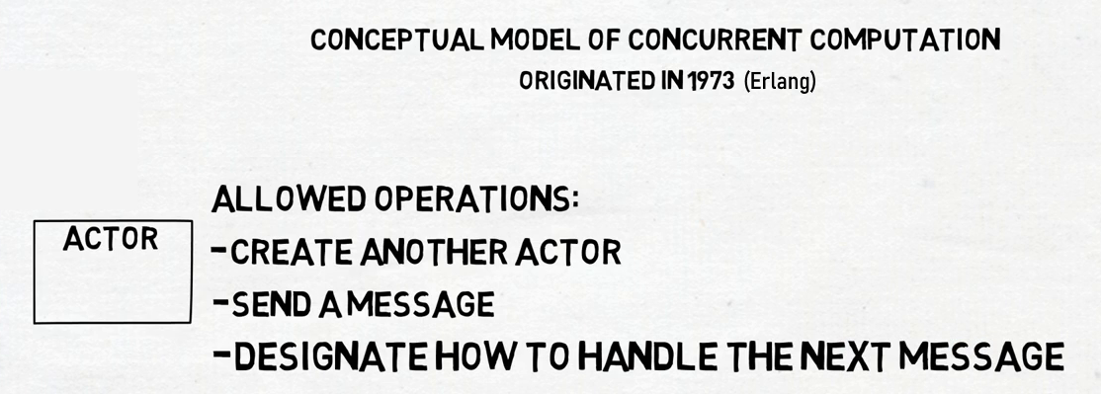
What is the Actor Model?

Slide 4
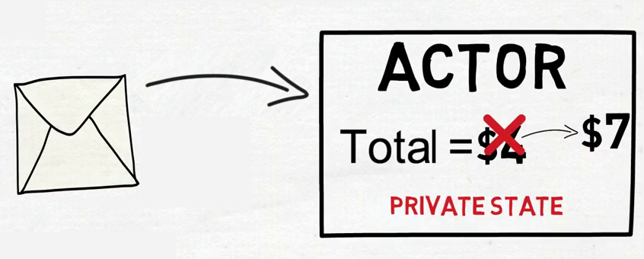
Actor Messages and States

Slide 5
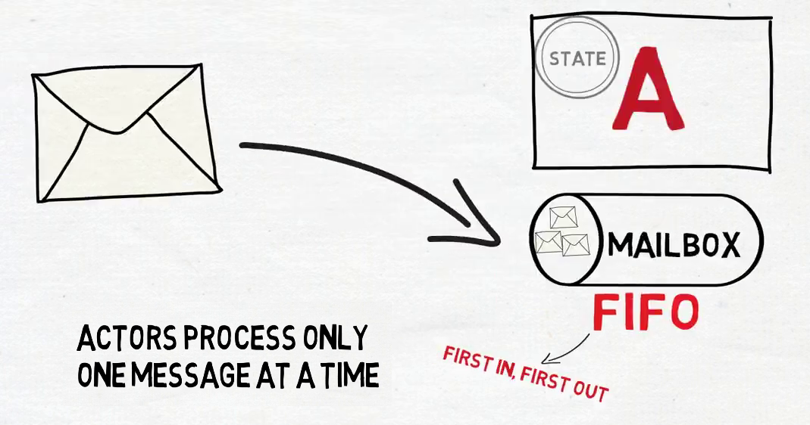
Mailboxes

Slide 6
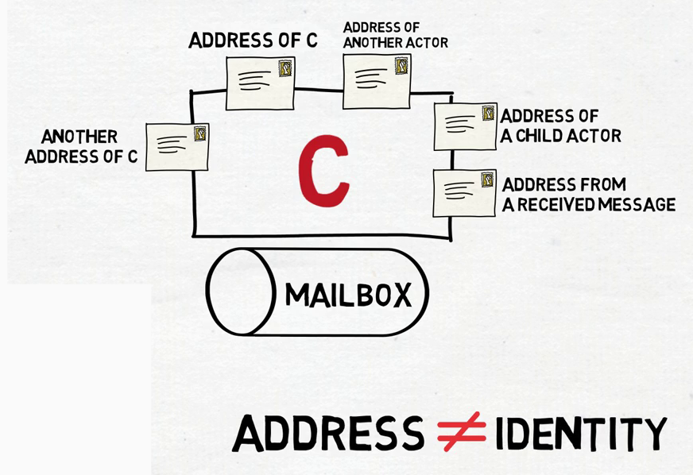
Actor Addresses and Identity

Slide 7
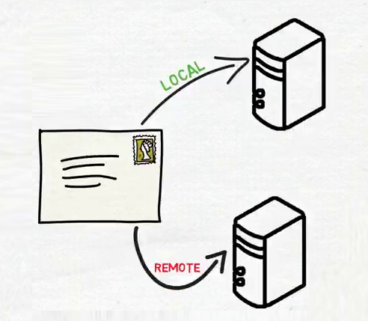
Distributed Actors

Slide 8
The Actor Model
For designing distributed applications.
Enables high concurrency and efficiency
Resilient against cascading failure in clusters
Based on behaviour of people
Self healing ability in failure

Slide 9
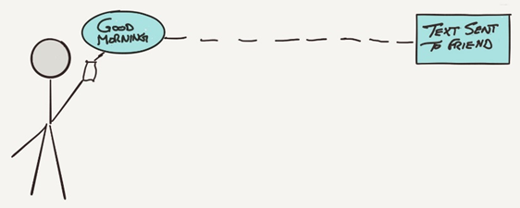
Actor Messaging

Slide 10
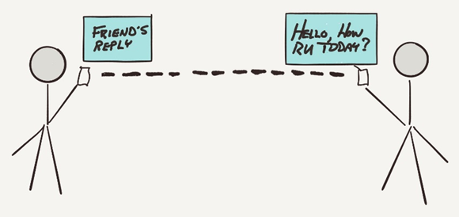
Actor Messaging

Slide 11
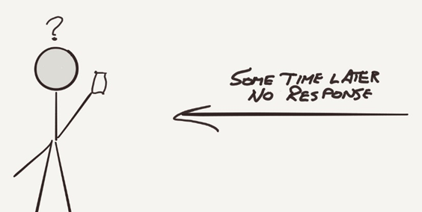
No Response

Slide 12
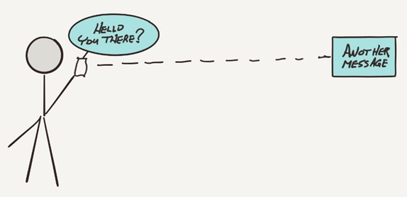
Send Another Message

Slide 13
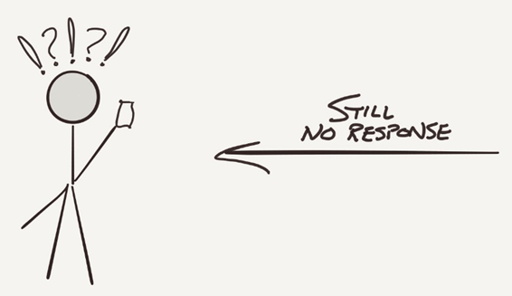
Still No Response

Slide 14
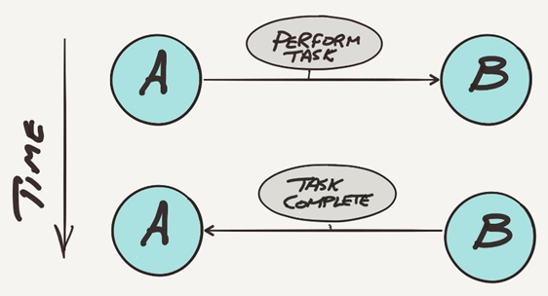
Ideal Situation

Slide 15
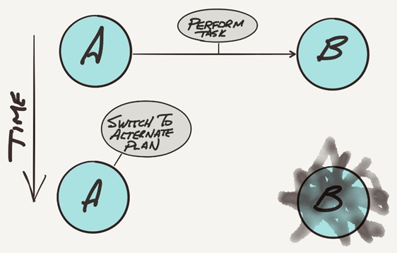
Alternate Plan

Slide 16
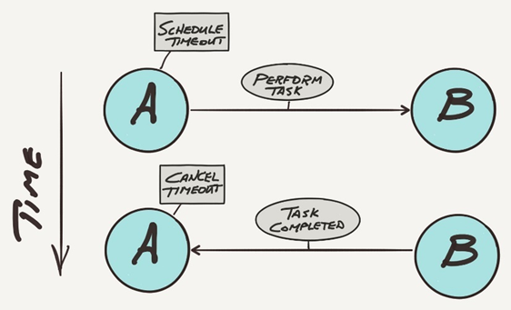
Timeout Cancelled

Slide 17
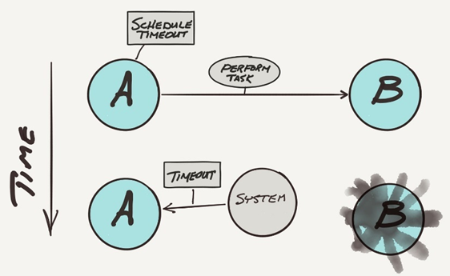
Timeout Expired

Slide 18
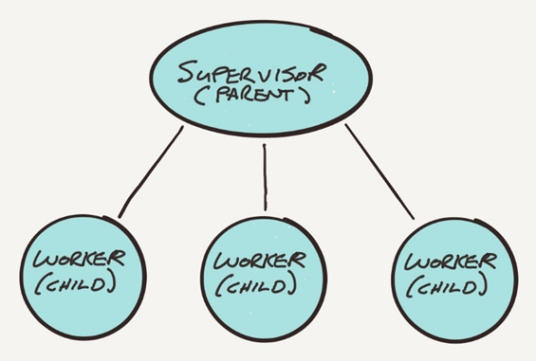
Supervisor actor creates worker actors

Slide 19
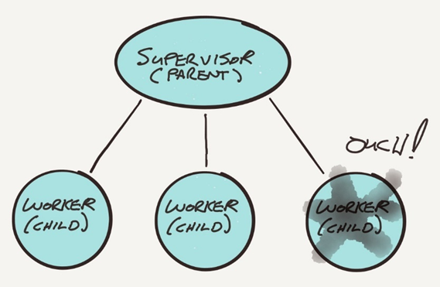
Worker actor has problem and notifies its supervisor

Slide 20
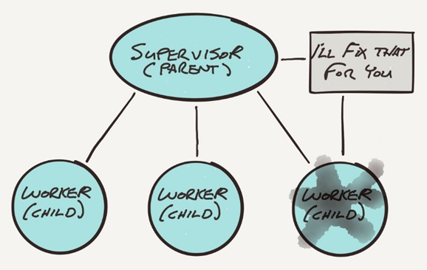
Supervisor fixes problem

Slide 21
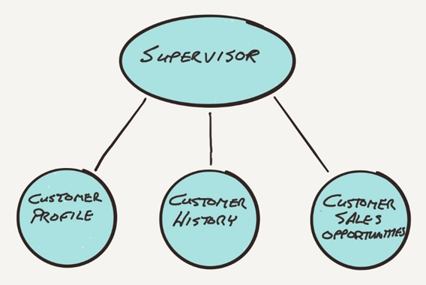
Supervisor actor delegates tasks to worker actors

Slide 22
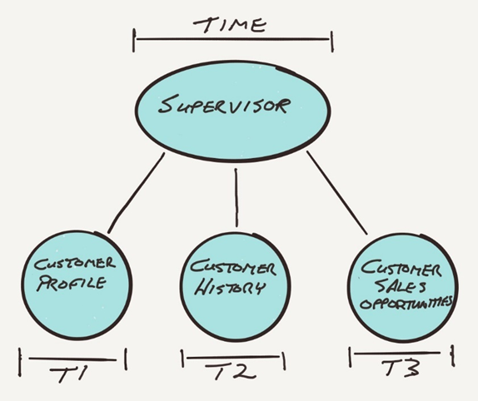
Worker actors perform tasks asynchronously

Slide 23
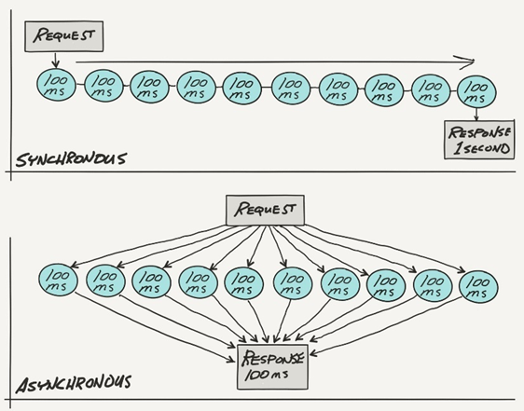
Asynchronous vs Synchronous
Ten 100 ms tasks performed synchronously(sequentially) take 1 second
The same ten tasks performed asynchronously take about 100 ms to complete

Slide 24
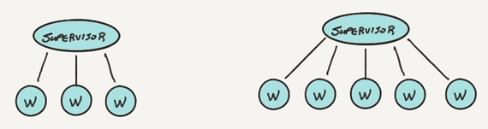
Actors and Scaling
. Supervisor adds more worker actors as the processing load increases

Slide 25
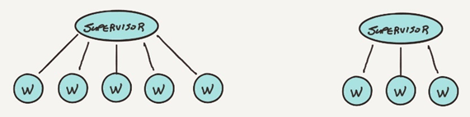
Actors and Scaling
The supervisor sheds workers as the load decreases

Slide 26
Scaling Large Systems
Actors exist within an actor system
actor system provides the protocol for messaging between actors
It also manages actor activities by allocating the system resources needed to support the actor environment.

Slide 27
Resources in a Computer System
Every computer system has a set of processing cores, memory, disk space, network interfaces, and so on
When programs run, the work is handled by a thread of execution.
With limited number of CPU cores and limited memory, there will be limited number of threads available.
The number of cores and the amount of memory determine how much work or threads a computer system is capable of handling.
This is similar to a room. Depending on the size of an office, more workers will fit in the room if it is larger, which means it can handle more work (threads).

Slide 28
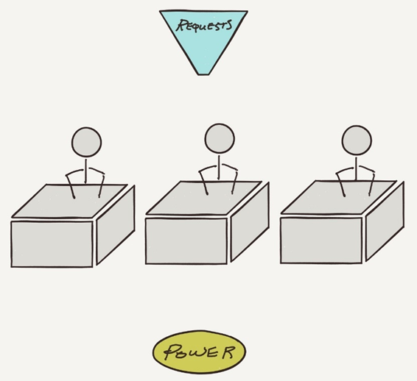
How Actors Manage Requests
An office example where workers sit at desks to perform tasks only when the desk has power

Slide 29
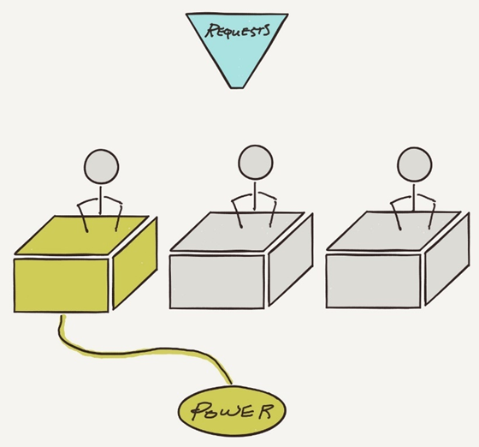
Requests Example
One desk has power, so the worker at that desk may work on its assigned task

Slide 30
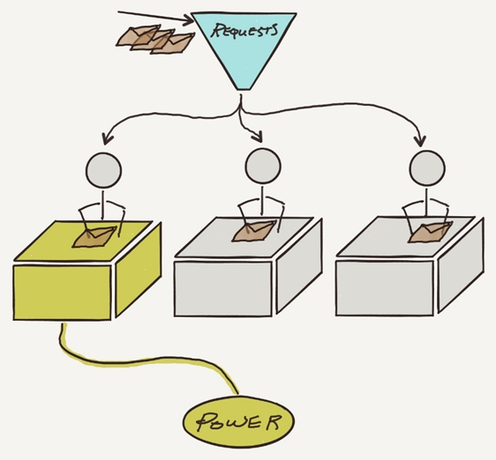
Requests Example
Messages are sent to the office and then routed to each worker

Slide 31
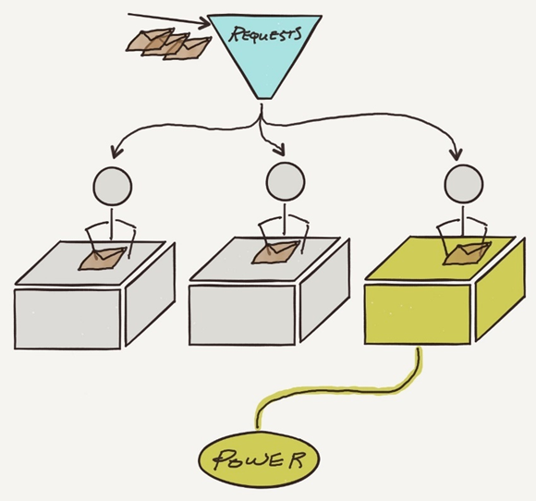
Requests Example
The system swaps the power between desks to allow an even distribution of work

Slide 32
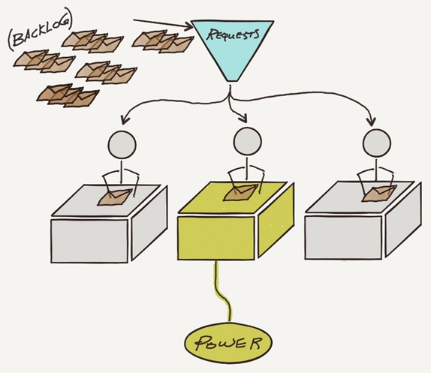
Traditional Threaded System
When messages arrive faster than the workers can perform each task, then there is a backlog of pending messages that are either queued or discarded

Slide 33
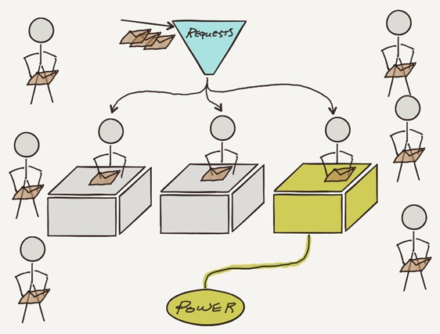
Asynchronous
In an asynchronous system, workers only occupy desks when they have something to do

Slide 34
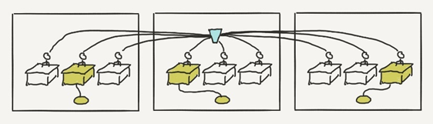
Actor Clusters
Actor systems may run in a cluster

Slide 35
Failure Detection and Recovery
There are a number of strategies available both at the actor level and at the actor system level.
Actors that create other actors are supervisors, and for error handling supervisors are notified when a worker hits a problem, and there are four common recovery steps:
Ignore the error and let the worker resume processing
Restart the worker and perform a worker reset
Stop the worker
Escalate the problem to the supervising actor of the supervisor
How a supervisor handles problems with a worker is not limited to these four recovery options, but other strategies may also be used when necessary.

Slide 36
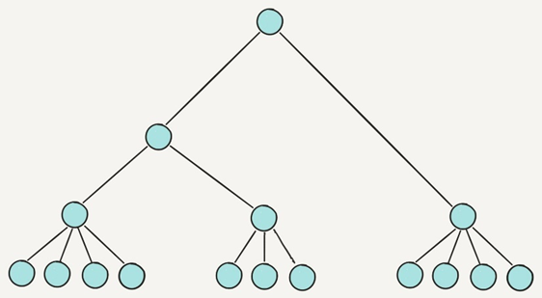
Actors form hierarchies

Slide 37
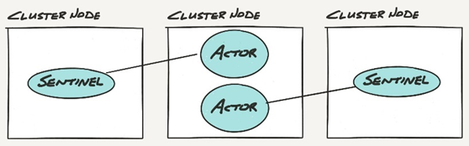
Actors Watching Actors
Sentinel actors watch actors on other nodes in the cluster

Slide 38
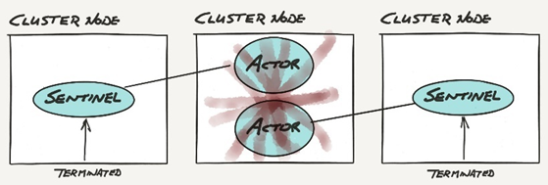
Actor Failure
When a node fails, the sentinel actors are notified via an actor terminated message

Slide 39
Dangerous Operations
Some actors need to perform "dangerous operations" outside of the actor system, which is more likely to fail from time to time, for example, query a database server.
To be successful, multiple external things need to be in place:
The database server needs to be running.
The network between the actors and the database server needs to be working.
When something fails, all of the actors that are trying to do database operations fail to complete their tasks.
In many cases this can triggers retries, where the systems automatically retry failed operations.
The end result is that the failed service may be hammered with requests and this increased load may hamper the recovery process.

Slide 40
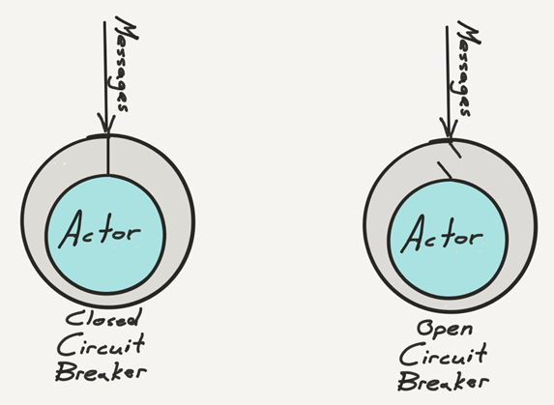
Circuit breakers
Circuit breakers can be used to stop the flow of messages to an actor when something unusual happens

Slide 41
Failures and Circuit Breakers
Actor supervision handles workers that run into trouble, handling error recovery that frees workers to focus on the task at hand.
Actors may watch for the termination of other actors and react appropriately when this happens.
Actors may be wrapped in a circuit breaker that can stop the flow of messages to an actor that is unable to perform tasks due to some other, possibly external, problem.
Circuit breakers allow for graceful recovery and self-healing, stemming the flow of traffic to a failed service to accelerate the service recovery process.
Actors may be cluster aware and designed to be notified when nodes join or leave the cluster. This can be used to react to the cluster changes

Slide 42

End

